Slide 1
Functions

Slide 2
Introduction
Divide and conquer
Large program are developed and maintained from smaller pieces known as modules which are more manageable. This technique of program development is known as divide and conquer.
Modules in C++ are called functions
What is a Functions then?
A function is a named, independent section of C++ code that performs a specific task and optionally returns a value to the calling program.

Slide 3
Parts of this definition:
A function is named. Each function has a unique name. By using that name in another part of the program, you can execute the statements contained in the function. This is known as calling the function. A function can be called from within another function.
A function is independent. A function can perform its task without interference from or interfering with other parts of the program.
A function performs a specific task. This is the easy part of the definition. A task is a discrete job that your program must perform as part of its overall operation, such as sending a line of text to a printer, sorting an array into numerical order, or calculating a cube root.
A function can return a value to the calling program. When your program calls a function, the statements it contains are executed. If you want them to, these statements can pass information back to the calling program.
The function which sends the data to another function is called as the Calling Function and the function which is called by the calling function is called as the Called Function.

Slide 4
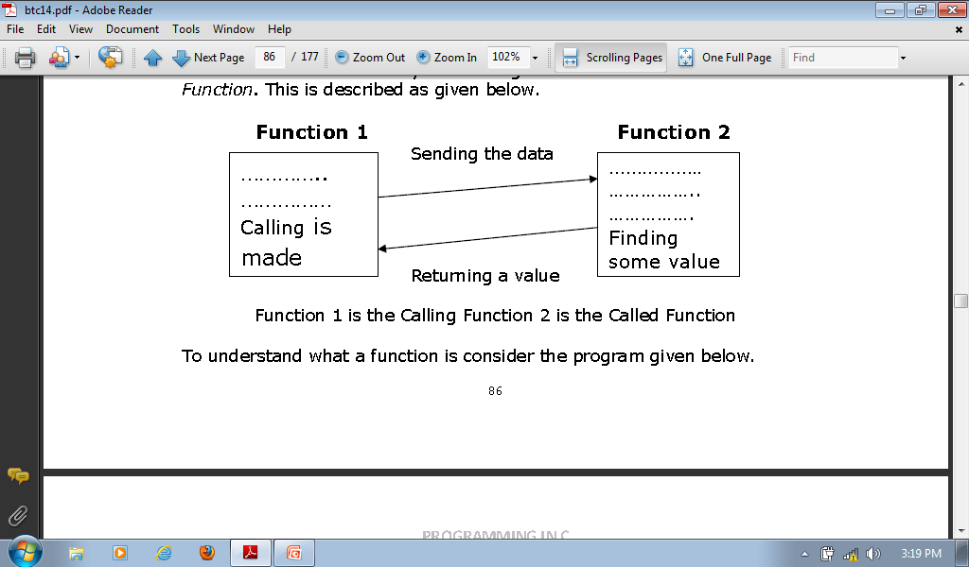

Slide 5
Benefits of functions
Divide and conquer
Manageable program development
Software reusability
Use existing functions as building blocks for new programs
Abstraction - hide internal details (library functions)
Avoid code repetition
Note: Each function should be limited to performing a single a well defined task and the function name should effectively express that task. This facilitates abstraction and promotes reusability.

Slide 6
Functions
In order to use functions, the programmer must do the following three things:
Function Declaration
Function Definition
Function call/ Invocation
A function declaration tells the compiler about a function's name, return type, and parameters.
A function definition provides the actual body of the function or in other words the codes to realize the task of the function.
The call constitutes a statement that triggers the execution of a defined function after all the parameters are initialized to the values of arguments.

Slide 7
Declaration of a function
Functions can be declared before they are defined and called.
However the same as a variable can be declared and initialized with the same statement, it is possible to combine declaration and definition of a function into one stage of the program.
Syntax of function declaration:
Return_type function_Name(parameters list);

Slide 8
Function declaration cont..’d
Function declaration tells the compiler,” a function that looks like this is coming up later in the program”, so it is like seeing reference of it before the function itself.
To declare a function simply state the data type the function returns, the function name and in brackets list the type of parameters in the function definition.
There must be the semicolon at the end.
E.g:
a) int max(int num1, int num2);
b) void swap(int *x, int &y);

Slide 9
Function definition
The general form of a C++ function definition is as follows:
return type function_name( parameter list )
{
body of the function
}
A C++ function definition consists of:
a function header and
a function body.

Slide 10
Function definition-Here are all the parts of a function:
Return Type: A function may return a value. The return_type is the data type of the value the function returns. Some functions perform the desired operations without returning a value. In this case, the return_type is the keyword void.
Function Name: This is the actual name of the function. The function name and the parameter list together constitute the function signature.
Parameters: A parameter is like a placeholder. When a function is invoked, you pass a value to the parameter. The parameter list refers to the type, order, and number of the parameters of a function. Parameters are optional; that is, a function may contain no parameters. They constitute the basic inputs for the function and get values or initialized by argument when the function is called.
Function Body: The function body contains a collection of statements that define what the function does.

Slide 11
Example function definition
Function returning the max between two numbers
int max(int num1, int num2) //return type, function name & parameters
{
// local variable declaration
int result;
if (num1 > num2)
result = num1; function body
else
result = num2;
return result;
}

Slide 12
Call of a function
While creating a C++ function, you give a definition of what the function has to do. To use a function, you will have to call or invoke that function.
When a program calls a function, program control is transferred to the called function. A called function performs defined task and when its return statement is executed or when its function-ending closing brace is reached, it returns program control back to the main program.
To call a function you simply need to pass the required parameters along with function name and if function returns a value then you can store returned value.
Format:
Storing_variable=function_Name(parameter s);

Slide 14
Hierachiacal boss function/worker function relationship
Main
Worker1
Worker2
Worker3
Worker4
Worker5

Slide 15
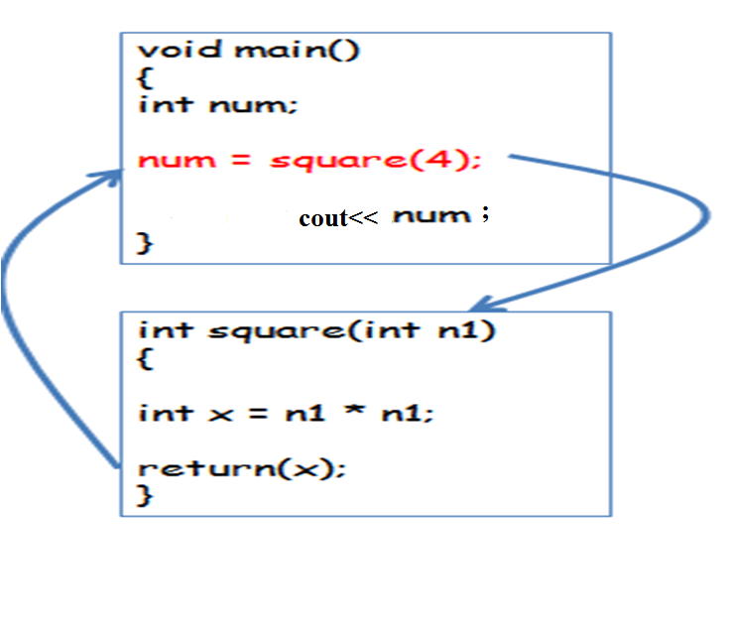

Slide 16
Example function declaration, function definition and call of a function
#include <iostream>
using namespace std;
// function declaration
int max(int num1, int num2);
int main ()
{
// local variable declaration:
int a = 100;
int b = 200;
int ret;
// calling a function to get max value.
ret = max(a, b);
cout << "Max value is : " << ret << endl;
return 0;
}
/* function returning the max between two numbers */
int max(int num1, int num2)
{
// local variable declaration
int result;
if (num1 > num2)
result = num1;
else
result = num2;
return result;
}

Slide 17
PARAMETERS, ARGUMENTS AND SCOPE OF VARIABLES
Parameters
Parameters constitute variables keeping values that are used as basic inputs for the function.
Parameters are associated with function declaration and definition. They are one of the ways of coupling the calling with the called function, where the calling function provides the required input to the called function.
A parameter can be a classic variable, a pointer, an address of a variable, an array or a structure.

Slide 18
PARAMETERS, ARGUMENTS AND SCOPE OF VARIABLES cont..’d
Arguments
An argument is the value that is passed to the function in place of a parameter.
When a function is called, all of the parameters of the function are created as variables, and the value of the arguments are copied into the parameters.

Slide 20
// Example - function using two int parameters by value
#include<iostream>
void printTime (int hour, int minute) //parameters
{
cout << hour;
cout << ":";
cout << minute;
}
int main void(){
int hour = 11;
int minute = 59;
printTime( hour, minute ); //arguments
}

Slide 21
Class work
Write a program which incorporates a function using parameter passing and performs the addition, of three numbers. The main section of the program is to print the result.
Write a program using the user defined functions concept to receive the marks of a student from the main function and returns the grade of the marks. The main section of the program should print the grade.
Write a program using the user defined functions concept to accept the marks of a student and print the grade.

Slide 22
PARAMETERS, ARGUMENTS AND SCOPE OF VARIABLES cont..’d
There are 2 primary methods of passing arguments to functions:
pass by value,
pass by reference,

Slide 23
Pass by Value
By default, arguments in C++ are passed by value.
When arguments are passed by value, a copy of the argument is passed to the function
(to the called function parameters). The changes made to the parameter do not affect the
arguments. Pass by value mechanism provides security to the calling program.
#include <iostream>
#include<conio.h>
using namespace std;
void foo(int y)
{
cout << "y = " << y << endl;
}
int main()
{
foo(5); // first call
int x = 6;
foo(x); // second call
foo(x+1); // third call
getch();
return 0;}
Output
Y=5
Y=6
Y=7

Slide 24

#include<iostream>
using namespace std;
int add(int n);
int main()
{
int number,result;
number=5;
cout << " The initial value of number : " << number << endl;
result=add(number);
cout << " The final value of number : " << number << endl;
cout << " The result is : " << result << endl;
return(0);
}
int add(int number)
{
number=number+100;
return(number);
}

Slide 25
Pass by reference
Pass by reference is the second way of passing parameters to the function.
The address of the argument is copied into the parameter.
The changes made to the parameter affect the arguments.
The address of the argument is passed to the function and function modifies the values of the arguments in the calling function.
Following is a program which illustrates the working of pass by reference mechanism.

Slide 26

#include<iostream>
using namespace std;
int adding(int *p)
{
*p=(*p)+100;
return(*p);
}
main ()
{
int number;
int result;
number=5;
cout << "The value of the variable number before calling the function : " << number << endl;
result=adding(&number);
cout << "The value of the variable number after the function is returned : " << number << endl;
cout << "The value of result : " << result << endl;
return(0);
}

Slide 27
Read
Pass by address

Slide 28
PARAMETERS, ARGUMENTS AND SCOPE OF VARIABLES cont..’d
Scope of variables
A scope is a region of the program and broadly speaking there are three places where variables can be declared:
Inside a function or a block which is called local variables,
In the definition of function parameters which is called formal parameters.
Outside of all functions which is called global variables.

Slide 29
Local variables
Variables that are declared inside a function or block are local variables.
They can be used only by statements that are inside that function or block of code.
Local variables are not known to functions outside their own.
Following is the example using local variables:
#include <iostream>
using namespace std;
int main ()
{
// Local variable declaration:
int a, b;
int c;
// actual initialization
a = 10;
b = 20;
c = a + b;
cout << c;
return 0; }

Slide 30
Global variables
Global variables are defined outside of all the functions, usually on top of the program.
The global variables will hold their value throughout the lifetime of your program.
A global variable can be accessed by any function. Example:
#include <iostream>
using namespace std;
// Global variable declaration:
int g;
int main ()
{
// Local variable declaration:
int a, b;
// actual initialization
a = 10;
b = 20;
g = a + b;
cout << g;
return 0; }

Slide 31
#include <iostream>
using namespace std;
// Global variable declaration:
int g, result;
int main ()
{
// Local variable declaration:
int a, b;
// actual initialization
a = 10;
b = 20;
g = a + b;
cout << g<<endl;
g=squre(a);
cout<<g;
return 0; }
int squre (int num)
{
g=num*num;
return g;
}

Slide 32
NB: When a local variable is defined, it is not initialized by the system, you must initialize it yourself. Global variables are initialized automatically by the system when you define them as follows:
Data Type Initialiser
Int 0
Char '\0'
Float 0
Double 0
Pointer NULL

Slide 33
FUNCTION OVERLOADING
C++ provides a feature to define two or more functions with the same name but different argument list. This is known as function overloading.
It is the compiler job which one is the right to choose.

Slide 34
#include<iostream>
using namespace std;
// two functions with same name but different parameter list
int add ( int, int );
int add ( int, int, int );
// adds two numbers
int add ( int a, int b ) {
return (a + b);
}
// adds three numbers
int add ( int a, int b, int c ) {
return (a + b + c);
}
int main() {
int x = add (5, 4);
int y = add (2, 6, 11);
cout << x << " " << y << endl;
return 0; }

